Slide 1

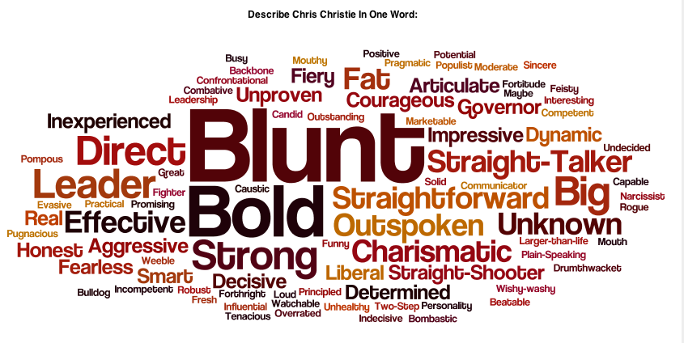
Topic: The Self & Personality
Aim: How does our sense of self develop and change over time?
Do Now: What are some environmental factors that help shape our personality?

Slide 2
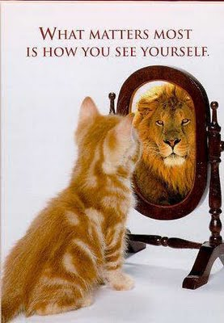
The Nature of the Self:
Self Concept: the content of the self (our knowledge about who we are), and to the knower aspect as self-awareness, which is the act of thinking about ourselves.
Chimps and orangutans, and possibly dolphins, have a rudimentary self-concept.They realize that the image in the mirror is themselves and not another animal
Notes:
In this chapter, we will consider both aspects of the self—the nature of the self-concept and how we come to know ourselves through self-awareness.

Slide 3
You are to imagine you are going to meet someone for the very first time. All that person has to know who you are will be your self-description, which will begin with the phrase:
“You’ll know me, I’ll be the one who…” Think of how to describe yourself in terms that don’t just rely on your physical appearance. What else about you might come across as unique?
DO NOT:
Write anything like “I’ll be in the red shirt” or “I’ll have the blue bag”
Give overly physical descriptions about yourself such as “I’ll be the one with the blue eyes, brown hair, 5’10”, etc)

Slide 4
5 primary factors:
External Environment (other people, where you grew up, parents, the way other react to you, etc)
Interpretation of Experiences (how you feel about things that have happened to you –good or bad)
Abilities (certain capabilities, either physical or intellectual that a person may have)
Unconscious motives (behavior a person may exhibit based on motives they are unaware of)
Expectations (what a person expects from themselves, others, and the world)

Slide 5
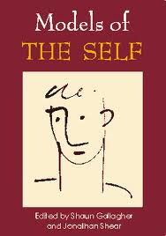
Activity:
Number 1-5 in your notebook
Write down 5 words or phrases which describe who you are:
You can use any way you can think of to describe how you view yourself (both physical and non-physical descriptions

Slide 6
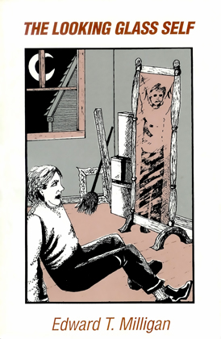
Cooley’s “Looking Glass Self”:
Describe how we develop a sense of self-concept.
We imagine how we appear to those around us
We interpret their reactions
We develop a sense of self based on their reactions
The ‘Social Mirror’

Slide 7
Cultural Differences in Defining the ‘Self’
Independent View of the Self:
A way of defining oneself in terms of one’s own internal thoughts, feelings, and actions and not in terms of the thoughts, feelings, and actions of other people.
Interdependent View of the Self:
A way of defining oneself in terms of one’s relationships to other people; recognizing that one’s behavior is often determined by the thoughts, feelings, and actions of others.
Notes:
(Kitayama & Uchida, 2005; Markus & Kitayama, 1991, 2001; Nisbett, 2003; Triandis, 1995)

Slide 8
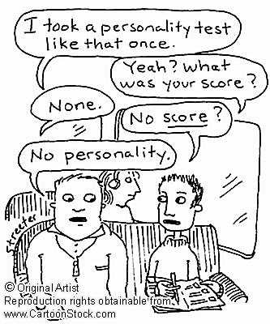
How would you define the term “personality”? Write your own definition.

Slide 9
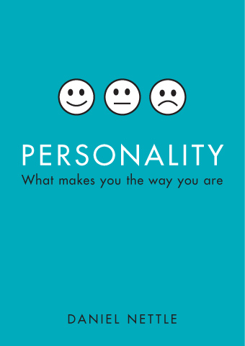
Personality: consists of the consistent, enduring, and unique characteristics of a person.
Traits: Any way in which one individual differs from another, or the predisposition to respond in a certain way to different circumstances.
Examples: nice, smart, arrogant – How would you describe your own personality traits?

Slide 10

Cardinal Trait: one that is so pervasive that the person is almost identified with the trait alone
Extravert: an outgoing, active person who directs energy towards other people and things
Introvert: a reserved, withdrawn person who is preoccupied with his/her inner thoughts and feelings
Activity: Personality Test #1

Slide 11
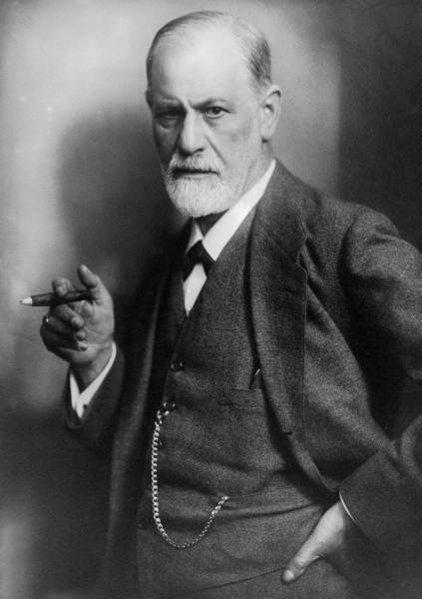
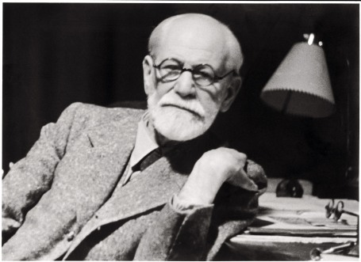
Freud & the Self:
Sigmund Freud argued that every personality has a large unconscious, or unaware, component.
Believed experiences were stored in the unconscious. These experiences affect our behavior
Activity: In your notebook, write down exactly what you feel like doing right now or in the next few minutes. You may write anything that you like, whatever you truly feel like doing.

Slide 12
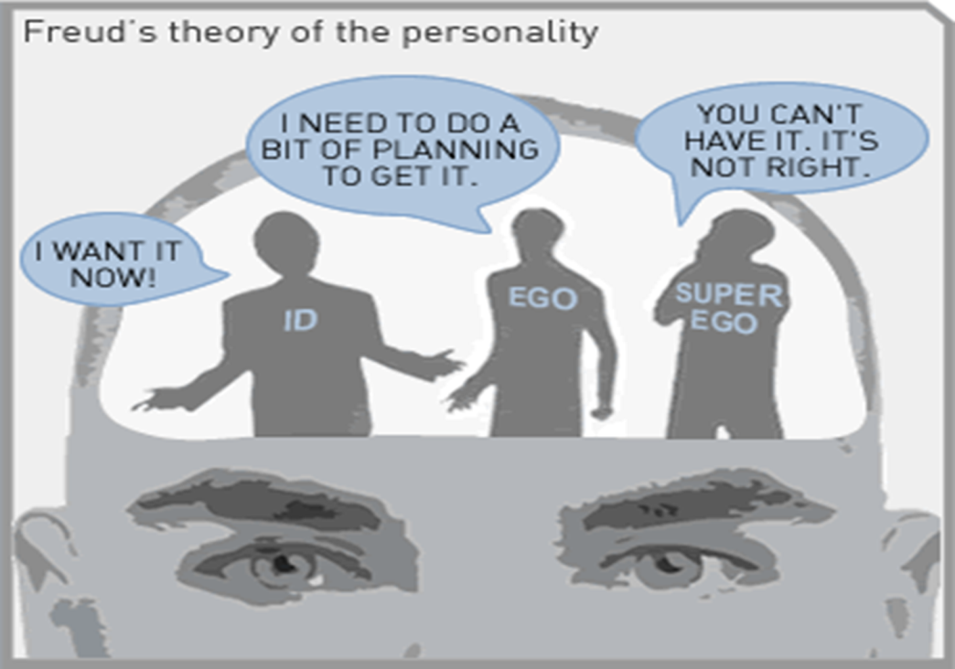
The ID: container of the instinctual and biological urges that operates on the “pleasure principle”
The EGO: the rational, thoughtful personality process that operates on the “reality principle”
The SUPEREGO: serves to advocate what you should do, operates on the “moral principal, or conscience”
According to Freud, certain personality traits can be determined by the correct or incorrect development of the ID, EGO, and SUPEREGO

Slide 13
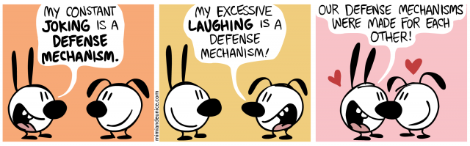
Defense Mechanisms:
Defense mechanisms protect us from being consciously aware of a thought or feeling which we cannot tolerate. The defense only allows the unconscious thought or feeling to be expressed indirectly in a disguised form.

Slide 14
    Denial: You completely reject the thought or feeling ("I'm not angry with him!”)
    Suppression: You are vaguely aware of the thought or feeling, but try to hide it. "I'm going to try to be nice to him."
    Reaction Formation: You turn the feeling into its opposite. "I think he's really great!"
    Projection: You think someone else has your thought or feeling. "That professor hates me.” "That student hates the teacher."
    Displacement: You redirect your feelings to another target."
    Rationalization: You come up with various explanations to justify the situation (while denying your feelings)."He's so critical because he's trying to help us do our best."
    Intellectualization: A type of rationalization, only more intellectualized. "This situation reminds me of how Nietzsche said that anger is ontological despair."
    Regression: You revert to an old, usually immature behavior to ventilate your feeling. "Let's shoot spitballs at people!"
    Sublimation: You redirect the feeling into a socially productive activity. "I'm going to write a poem about anger."

Slide 15
Imagine someone you do not like, or someone you outright hate. Write down things about that person’s personality that you dislike. Be specific.

Slide 16
What you have written down is some hidden part of yourself - some part that you have suppressed or hidden. It is what psychologist Carl Jung would call your SHADOW. Maybe it's a part of you that you fear, can't accept, or hate for some reason. Maybe it's a part of you that needs to be expressed or developed in some way. Maybe you even secretly wish you could be something like that person whom you hate.
What do you think about this?

Slide 17
Why?
Why did you choose the seat that you chose for this class?
What do people’s choices in seating around the classroom indicate about personality types (in your opinion).
For example, people who sit in the front, people who sit in the back, people who sit by the windows, people who sit alone, and people who sit in certain groups

Slide 18
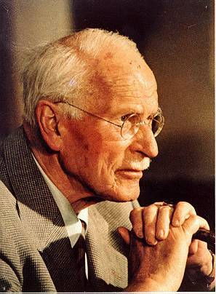
Other Theories of Personality:
Collective Unconscious: said the same archetypes (inherited, universal ideas, myths, dreams, etc) are present in all humans.
Reflect common experiences
Examples: Creation myths, Jack & Jill (David & Goliath)
Archetypes influence our thoughts and help shape our personalities
Carl Jung

Slide 19
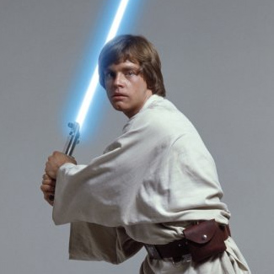
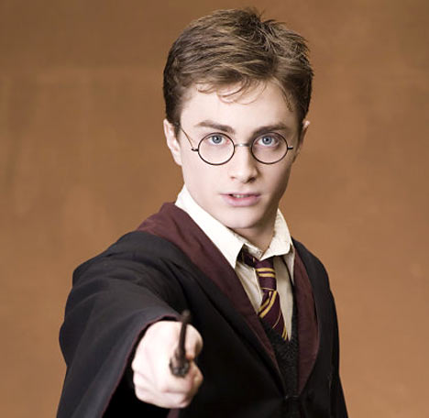
What cultural archetype do these characters represent?

Slide 20
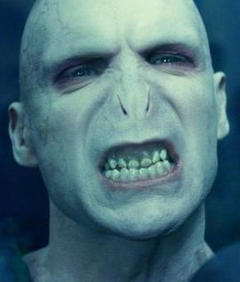
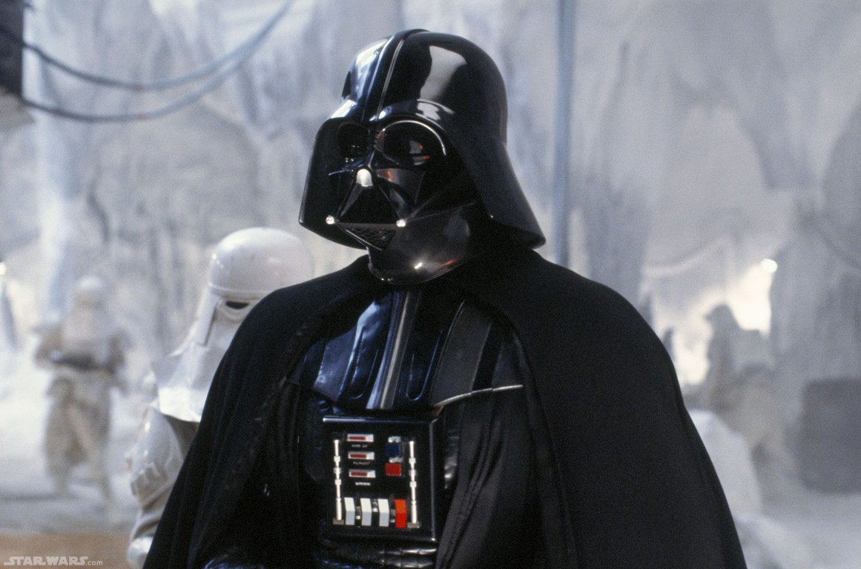
What about these?

Slide 21
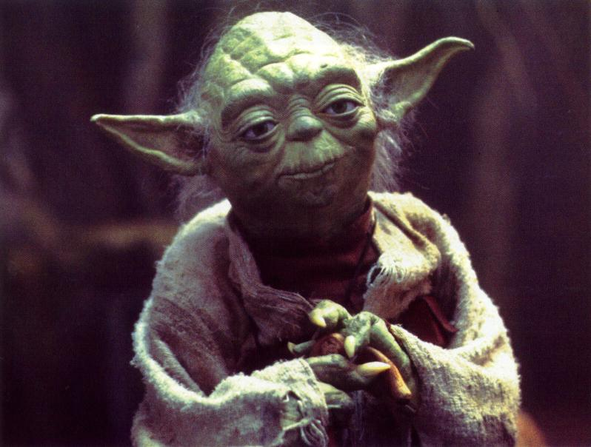
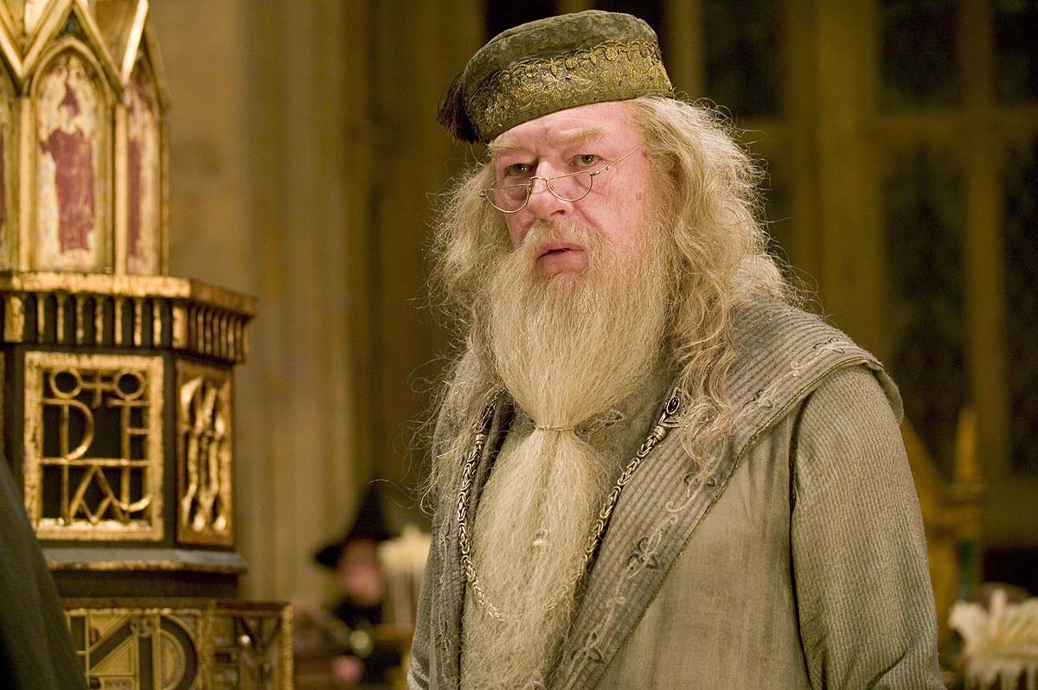
And These?

Slide 22
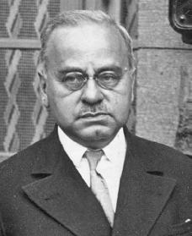
Other Theories of Personality:
Personality is formed through overcoming inferiorities (feelings of being less than everyone else in some respect)
Inferiority complex: people who continually try to overcome & avoid feelings of inadequacies
Can you list some common inferiorities you or someone you know has tried to overcome?
Alfred Adler

Slide 23
Locus of Control:
Person’s behavior depends on subjective beliefs.
Those who believe they have control over situations have an internal locus of control
Those who believe fate is determined by forces beyond their control have an external locus of control
In what areas of your life do you feel the most in control of? The least? Does this level of control impact your happiness?

